Slide 1
Key Insights for the presentation
Overall study of different parameters that affect sales volume
Understanding the impact of pricing on sales volume and what is the recommended price category
Forecasting how sales volume will change depending historical sales and prices data

Slide 2
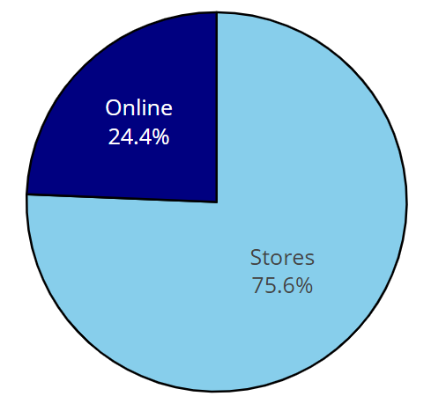

Percentage of Sales from store vs online in 2015
most of sales were made from store in 2015
Total Sales volume : 324346
Notes:
can you please give me insights:
the total volume of sales

Slide 3
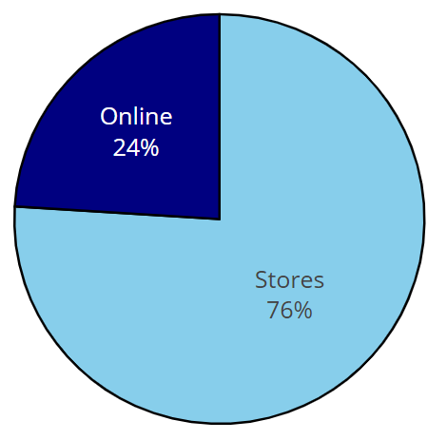

Percentage of Sales from store vs online in 2016
Most of sales were made from store in 2016 also
Total Sales volume : 121062
Notes:
can you please give me insights:
the total volume of sales

Slide 4
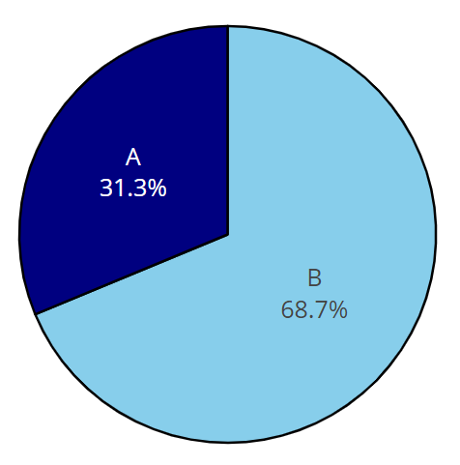

Percentage of Sales from Country A vs Country B in 2015
more sales were from Country B in 2015
Total Sales volume : 324346
Notes:
can you please give me insights:
the total volume of sales

Slide 5
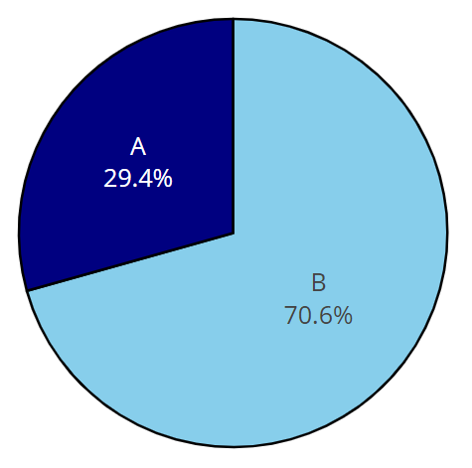

Percentage of Sales from Country A vs Country B in 2016
also more sales were from Country B in 2016
Total Sales volume : 121062
Notes:
can you please give me insights:
the total volume of sales

Slide 6
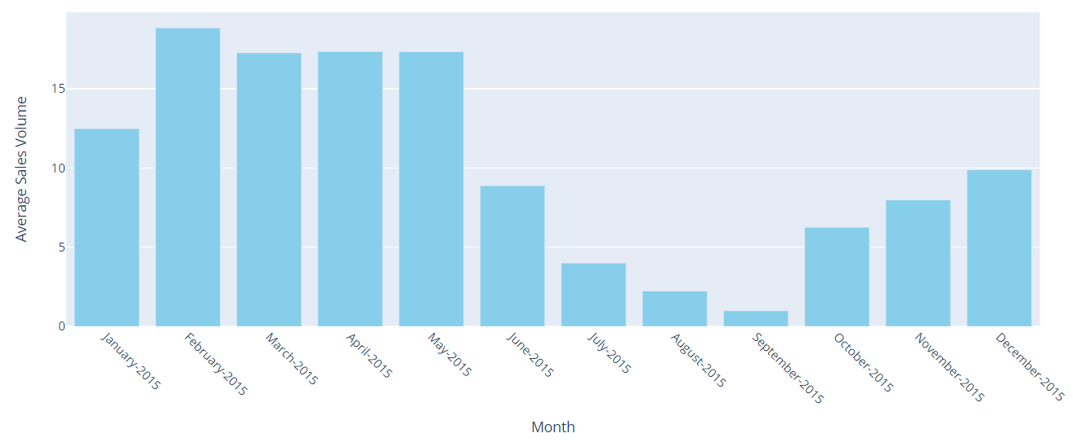
Average Sales per month in 2015
We can notice that from beginning of summer ( June ) the average sales decreased rapidly until september then it started to increase again !
Notes:
what is the unit of sale volume ?
Please add weekly sales volumes

Slide 7
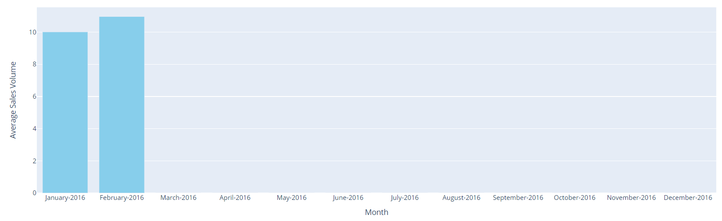
Average Sales per month in 2016
we only have 2 months on 2016 so no any remarkable trend we have here !
Notes:
please replaace this with a new graph similar to the previous slide
Please add weekly sales volumes

Slide 8
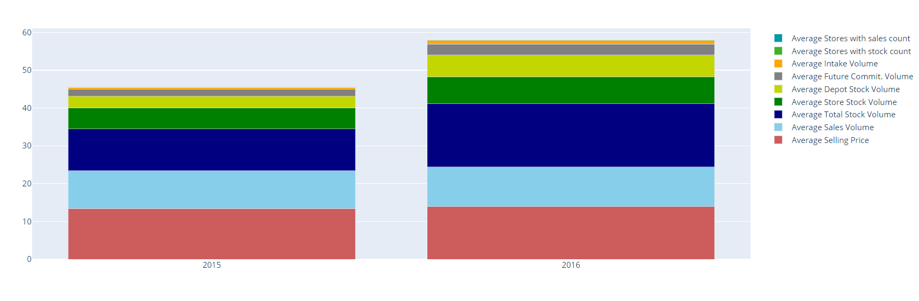
The average of different parameters on each year

Slide 9
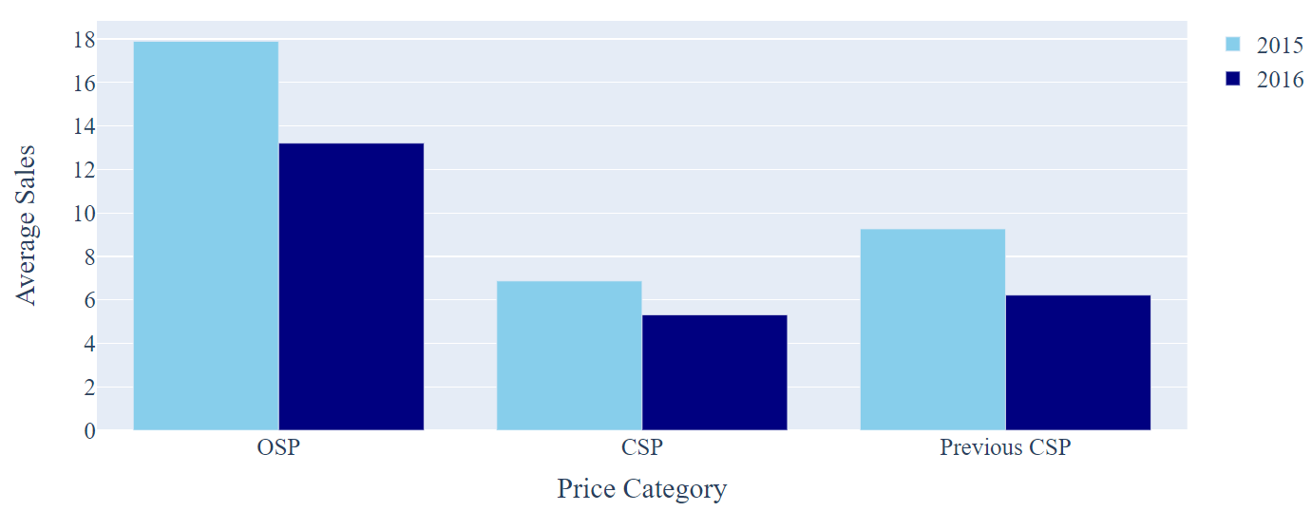
impact of pricing on sales volume
there are 3 prices changes or categories from the dataset we have
1- Original Selling Price ( OSP )
2- Previous Selling Price ( Previous CSP )
3- Current Selling Price ( CSP )
price category vs average sales in both 2015 and 2016
Notes:
nice graph, please add a another slide with the curve of these values ( we keep this slide too)

Slide 10
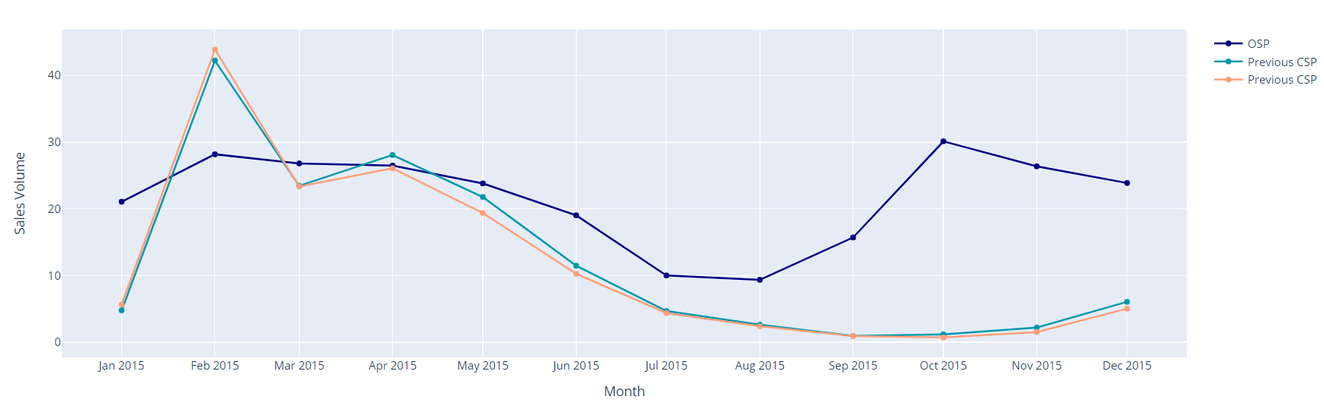
the 3 prices categories average sales volume per month 2015

Slide 11
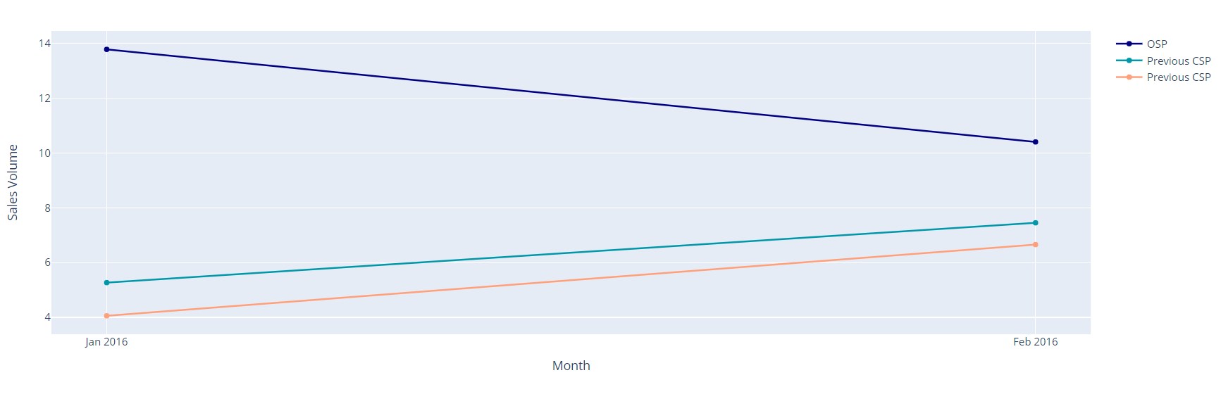
the 3 prices categories average sales volume per month 2016
Notes:
Great

Slide 12
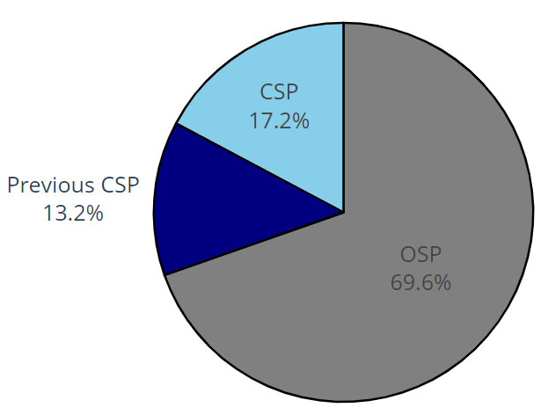
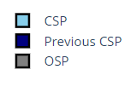
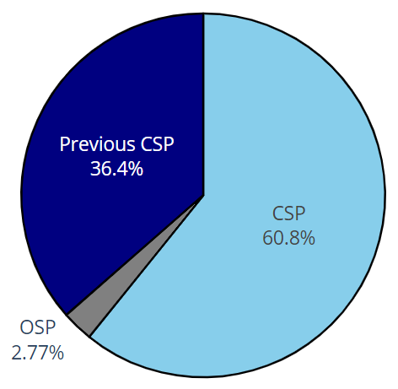
Why Sales Decreased in Summer ?
by looking at the percentages of products of each price category before and after summer , we can see that the reason the prices decreased in summer that only 2.77% of products are in OSP Price category , while before summer 69.6% of products are in OSP Price category
at Summer ( june -> September ) before Summer ( January -> May )
Notes:
can you please add a segmented histogram and put total sales and each category of prices at summer and before summer

Slide 13
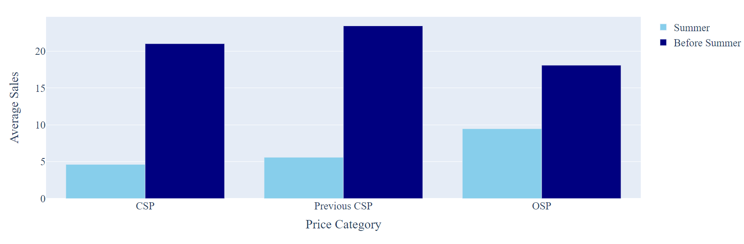
Price Categories average sales in summer and before

Slide 14
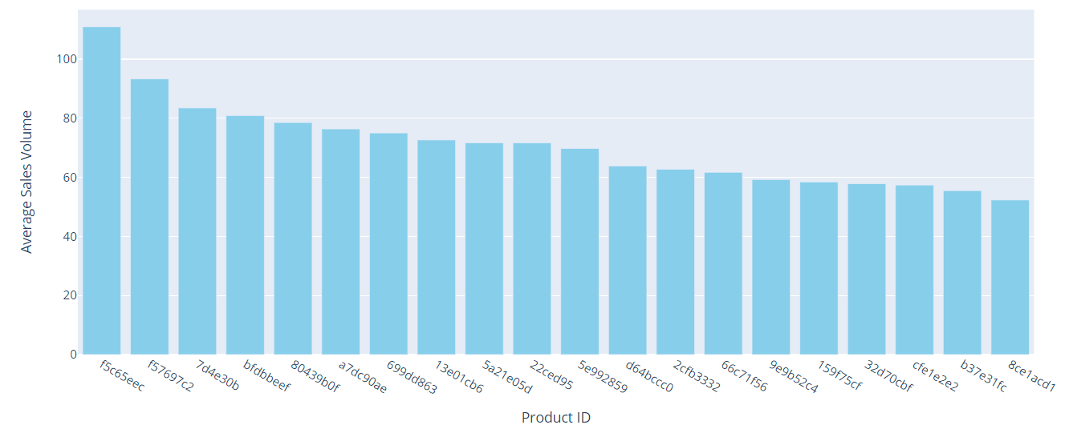
Top 20 Products with Average sales in 2015
-

Slide 15
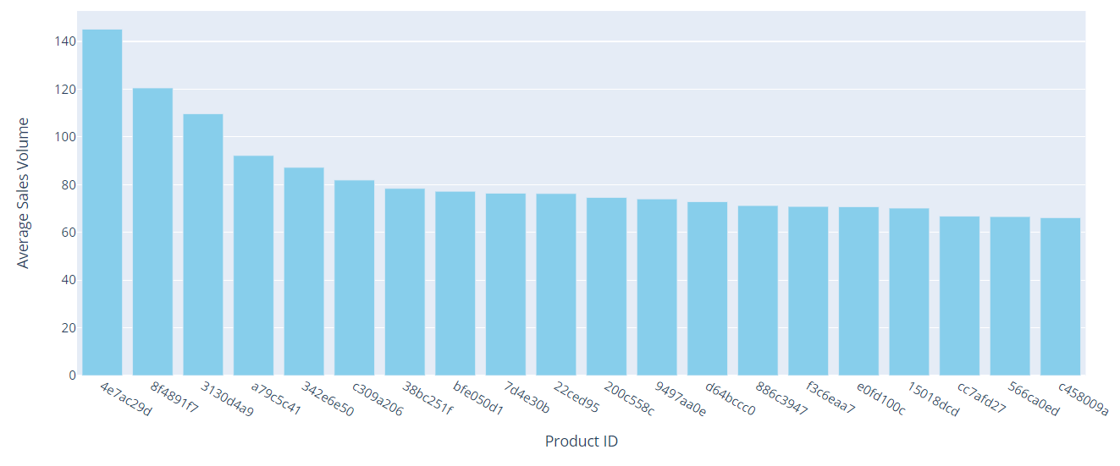
Top 20 Products with Average sales in 2016

Slide 16

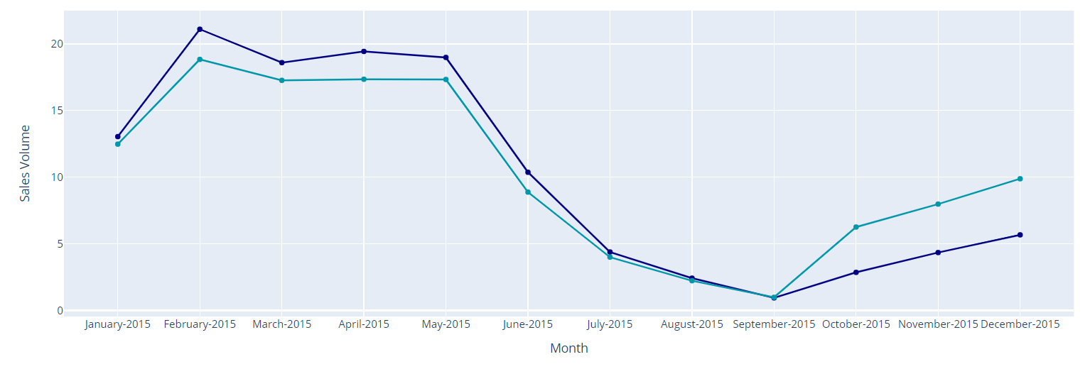
Forecasting how sales volume will change depending historical sales and prices data
Actual sales 2015 vs Predicted sales 2017

Slide 17
Recommendations
to change the price of products again to the original selling price ( OSP ) to get better sales in 2017
making sure that the top 20 products with average sales are exist in stock with enough amount
focusing more in digital marketing so that more sales come from online

